Slide 1

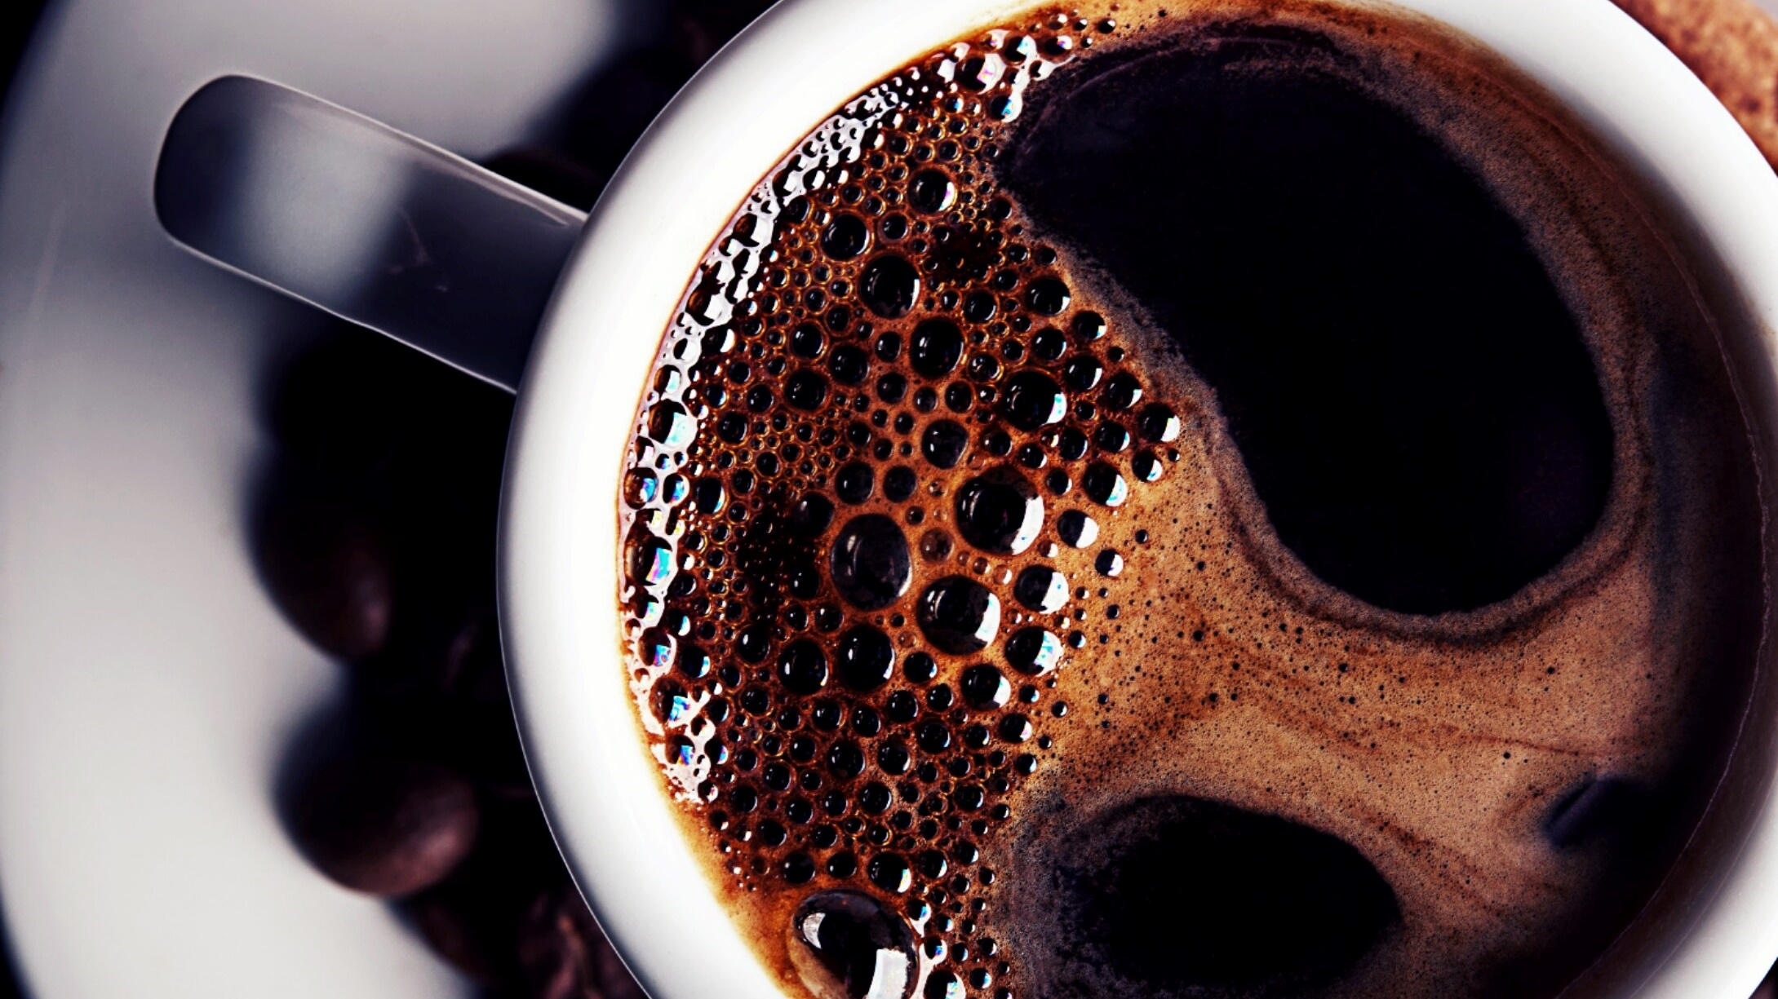
Bright Coffee Shop Sales Analysis
- October, 2025

Slide 2
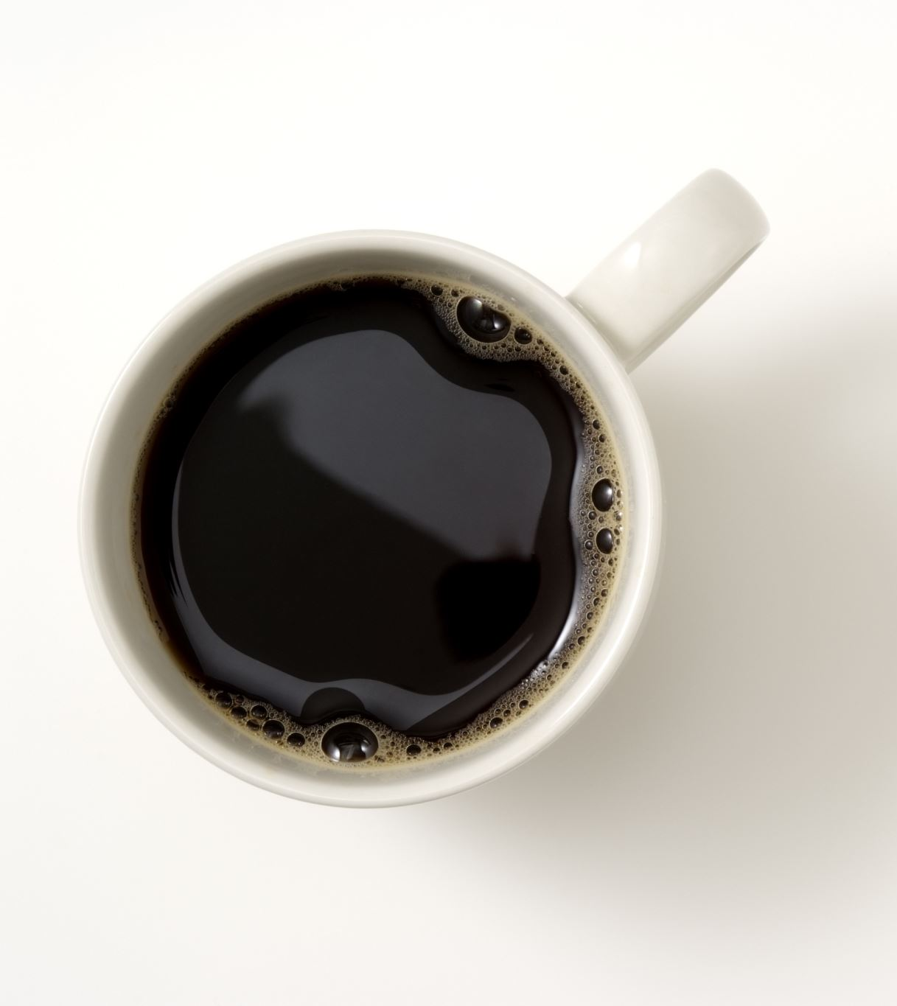
Bright Coffee Shop Objective
Which products generate the most revenue
What time of day the store performs best
Sales trends across products and time intervals
Recommendations for improving sales performance

Slide 3
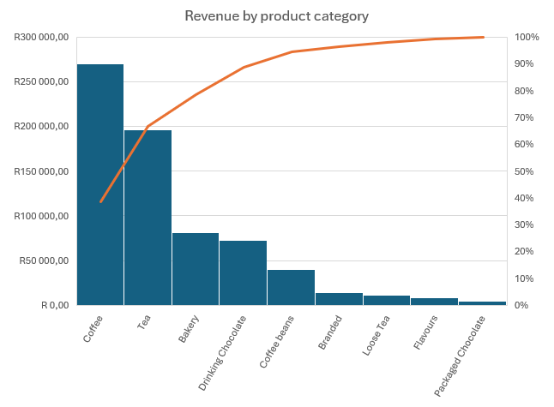
Which products generate the most revenue(1/2)
The bar graph shows that Coffee generates the highest revenue at R269,590.80, which makes up about 39% of total sales. It’s followed by Tea with R196,305.45 (28%) and Bakery with R81,365.14 (12%).
Together, these top three categories contribute almost 80% of the total revenue. This suggests that beverages, especially coffee and tea, are the main drivers of sales for the business.

Slide 4
Which products generate the most revenue(2/2)
The line graph shows that Barista Espresso generates the highest revenue at R91,101.90, making up about 13% of total sales. It’s followed by Brewed Chai Tea (R77,040.95 – 11%), Hot Chocolate (R72,390.50 – 10%), and Gourmet Brewed Coffee (R70,023.60 – 10%).
These top four products together contribute over 40% of total revenue, showing that coffee-based drinks and specialty teas are the main revenue drivers for the business.

Slide 5
What time of day the store performs best(1/2)
The line graph shows that sales peak between 8 AM and 10 AM, with the highest revenue recorded around 10 AM (R88,302.39).
This indicates that the stores perform best during the morning hours, likely due to customers buying coffee and breakfast items on their way to work.
Sales gradually decline after 11 AM, suggesting that mornings are the most profitable time of day for the business.

Slide 6
What time of day the store performs best(2/2)
The bar graph shows that the stores perform best in the morning, generating the highest total revenue of R386,471.07, which accounts for about 56% of overall sales.
This is followed by the afternoon (R203,896.28 – 29%) and the evening (R105,742.23 – 15%).
This indicates that most sales happen during the morning hours, likely driven by customers purchasing coffee and breakfast items to start their day.

Slide 7
Sales trends across products and time intervals(1/2)
The bar graph shows that the morning is the busiest time, generating R386,471.07 (56%) of total sales. The afternoon follows with R203,896.28 (29%), and the evening contributes R105,742.23 (15%).
Across all time periods, coffee (39%) and tea (28%) remain the top-selling products, especially in the morning. This trend highlights that most sales happen in the morning, driven by demand for hot drinks and bakery items.

Slide 8
Sales trends across products and time intervals(2/2)
The bar graph shows that weekday sales dominate, generating R502,520.09 (72%) of total revenue, while weekend sales contribute R194,854.09 (28%).
Coffee (39%) and Tea (28%) are the top-selling products, with the majority of their sales occurring on weekdays. Bakery items and drinking chocolate also sell well during the week but see smaller contributions on weekends.
Overall, the trend indicates that most sales happen during weekdays, driven mainly by hot beverages and bakery items.

Slide 9
Recommendations for improving sales performance
4. Promote High-Margin Products:
Coffee and tea are the top sellers. Consider upselling premium coffee drinks, specialty teas, or add-ons like pastries to increase revenue per customer.
5. Cross-Sell & Bundle:
Pair Bakery items or drinks with complementary products. For example, offer a “coffee + scone” bundle at a small discount to increase basket size.
6. Optimize Evening Offerings:
Evening sales are the lowest (15% of daily revenue). Introduce light snacks, desserts, or evening coffee specials to attract customers after work.
1. Focus on Peak Hours:
Morning sales (especially 8–10 AM) generate the highest revenue. Consider offering special promotions or combos during this time to increase average spend.
2. Boost Weekend Sales:
Weekends account for only 28% of total sales. Introduce weekend-only specials, loyalty rewards, or brunch bundles to attract more customers.
3 .Customer Engagement & Marketing:
Use social media and in-store promotions to highlight popular products, especially during off-peak hours, to drive foot traffic.

Slide 10
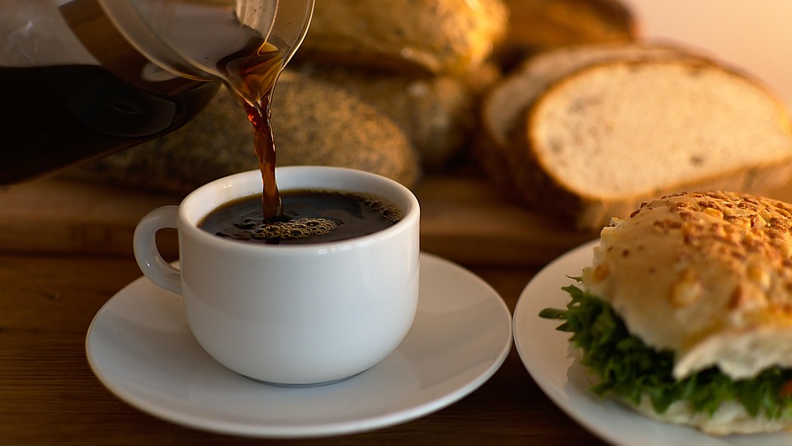
THANK YOU
Phindile Mnisi

